Slide 1

CODE-5 WEB DEVEOPEMENT
:

Slide 2
INTRODUCTION
THE SAMPLE DATA TO GENERATE A GST INVOICE ACCORDING TO THE GINEN SCHEMAS CAN BE GENERATED IN THE FORM OF PDF. FOR THE INVOCE WHICH INCLUDE : 1. HEADER INFORMATION 2. LINE INFORMATION AS PER THE SAMPLE ATTACHED .

Slide 3
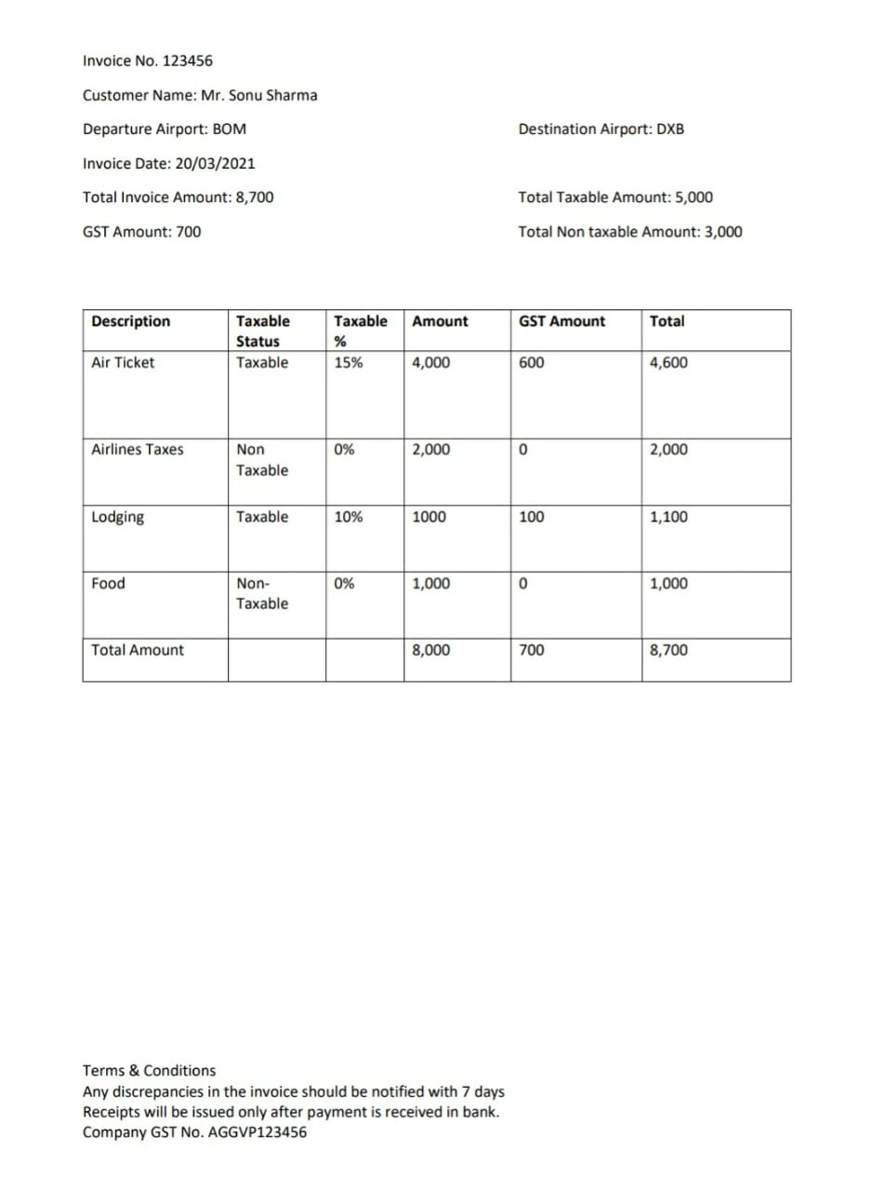
SAMPLE INVOICE :

Slide 4
AIRLINES DATA BASE :

